Slide 1
Technical Support (420-1N6-AB) Hardware – Servers
Fall 2023

Slide 2
Outline
What is a Server?
Server Hardware
Performance and Fault Tolerance

Slide 3
What Is A Server?
A server is a computer or device on a network that manages resources or provides functionality.
To private users inside an organization
Or to public users via the Internet.
Servers can provide various functionalities often referred as “Services”. Such as:
Sharing data.
Sharing/Hosting applications.
Sharing hardware.
Performing computation.

Slide 4

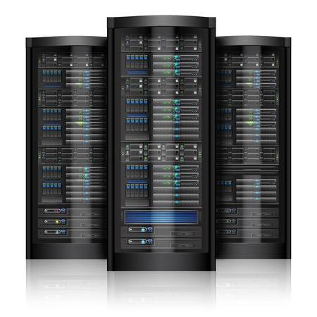
Client/Server Model
Internet / Network
Client sends request
Server send back data
Client
Server

Slide 5
Examples of Servers
File server
Stores and distributes files.
Print server
Allows the management and distribution of printing functionality.
Database server
Run database applications that store data and respond to numerous requests from clients.
Application server
Runs applications that are shared by a large number of users.
Clients do not need to have enough resources nor have to maintain the applications.
Mail server
Transfers and stores mail over corporate networks and across the Internet.
Web server
Hosts webpages and provides access to them across a network to the user's web browser.

Slide 6
Server Hardware

Slide 7
Differences Between Servers and Workstations
Servers perform a service (or services) for clients that are connected.
They may provide access to shared files, printers, other network resources, or may provide email and web hosting services.
Workstations are personal computers.
They are used for applications such as word processing, graphical design, development, browsing the web, etc.

Slide 8
Server Hardware Components
In many ways server hardware really isn’t all that different from a workstation PC hardware.
Servers use the same basic components such as:
CPUs.
Main memory.
Secondary storage.
Power supplies.

Slide 9
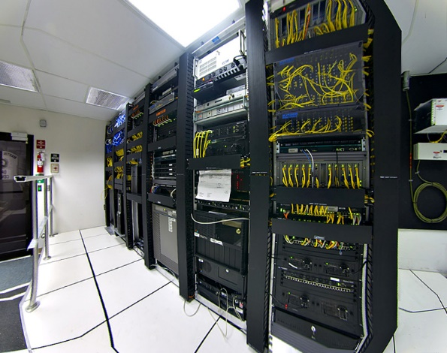
Server Hardware
Servers are
Noisy
Power hungry
Need good Internet access
Require increased security.
Servers are usually stored in dedicated server centers (or data centers).

Slide 10
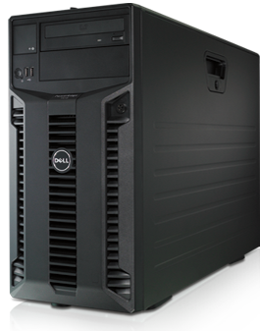
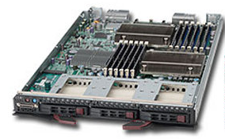
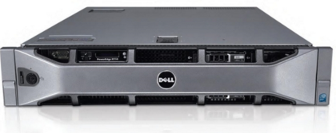
Types of Servers
(Form Factors)
Tower Servers | Rack Servers | Blade Servers

Slide 11
Tower Servers
Look like PCs.
Each tower server is a standalone machine.
Occupy space and tent to be noisy.
Usually used in small data centers.

Slide 12
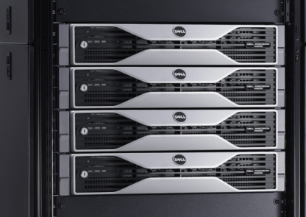
Rack Servers
Servers mounted within a rack.
Uniform width, various heights.
Server heights is measured using rack units.
A standard rack mount server is referred to as a 1U server meaning that it is 1 rack unit in size.
Each rack can accommodate multiple servers which are typically stacked one on top of the other.
Mounted to rack using screws.

Slide 13
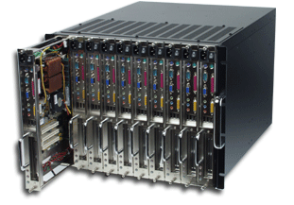
Blade Servers
Mount inside a special rack (chassis).
Blade servers tend to be vendor proprietary.
You can’t for example insert a Dell blade server into an HP chassis.
Lack certain components that rack servers have, e.g. power supplies.
The chassis can include a power supply, cooling unit, etc.

Slide 14
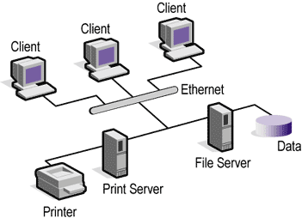
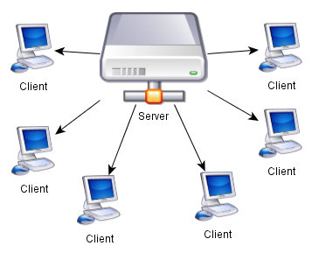
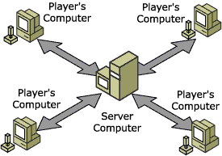
Server Models

Slide 15
Server Hardware vs Computer Hardware
In the hardware sense, the word server means hardware intended for hosting software applications under intense demand.
Most PCs can act as a server, but a dedicated server will contain features making it more suitable for production environments where performance and resilience are important.
Server hardware components are much more expensive.
There is a tradeoff between performance and expense.

Slide 16
Server Hardware Performance Features
Advanced CPUs
More cores
Extra cache
Hyperthreading
Server hard drives
Resistant to vibrations.
Large is size.
Fast access time.

Slide 17
Fault Tolerance
Fault tolerance is the property that enables a system to continue operating properly in the event of the failure of one (or more) of its components. (Wikipedia)
Fault tolerance is crucial in servers' environments.
Variety of fault tolerance mechanisms:
Redundant files, volumes or drives.
Redundant hardware components or servers.
Hardware components with recovery options.

Slide 18
Examples of Fault Tolerance
Redundant power supplies / Sources.
If one fails, the other takes over.
Use of UPS (Uninterruptible power supply)
Redundant network interface cards.
Provides fault tolerance.
Improvement in performance (Combined speed).
Memory Modules with error checking (ECC).
Can detect and correct the most-common kinds of internal data corruption.

Slide 19
Examples of Fault Tolerance
Redundant Storage:
Redundant Array of Inexpensive Disks (RAID)
RAID provides a way to store data across multiple hard disks for redundancy.
To the operating system, RAID appears as a single logical disk.
There different types of RAID setups.

Slide 20
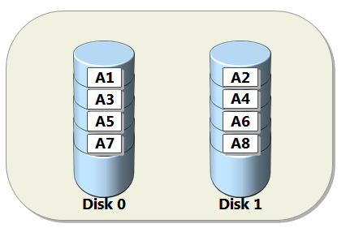
RAID 0
Known as disk striping where data is written across multiple disks.
No fault tolerance but excellent performance.
Why?
Minimum of 2 disks required.

Slide 21
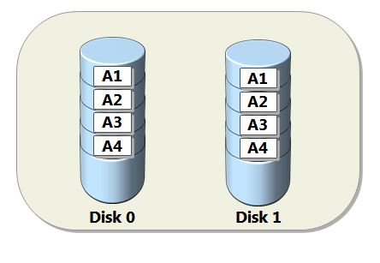
RAID 1
Disk mirroring where data is copied onto more than one drive simultaneously.
Simplest and cheapest way to implement fault tolerance.
Minimum of 2 disks required.
Advantages? Disadvantages?

Slide 22
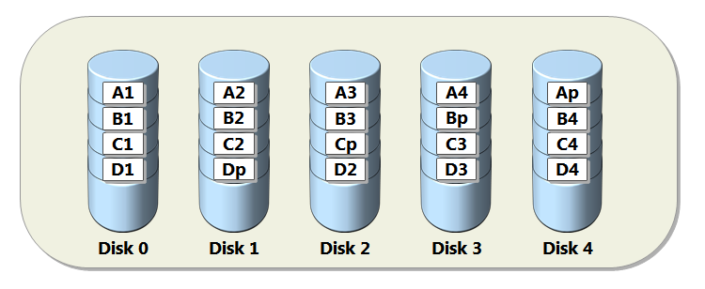
RAID 5
A common RAID configuration for business servers.
Data and parity (additional data used for recovery) is striped across 3 or more disks.
If a disk gets an error or starts to fail, data is recreated automatically.
Great solution for fault-tolerance, but slows down server performance.

Slide 23
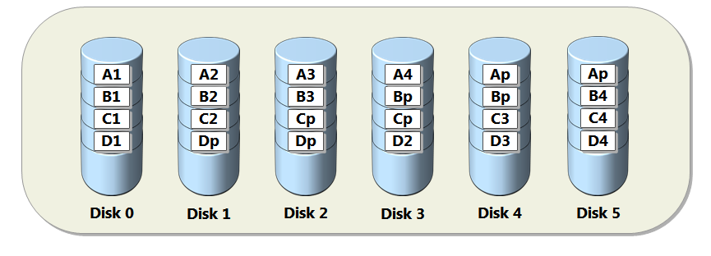
RAID 6
Identical to RAID 5 but uses one more parity block (more robust) (two disks can die).

Slide 24
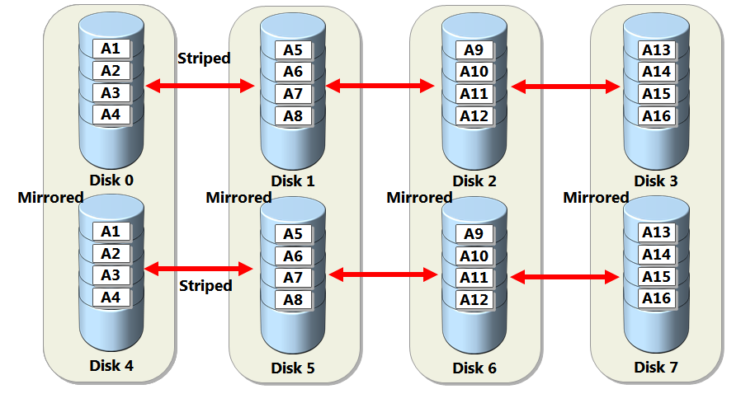
RAID 10 (1+0)
Combination of RAID 0 and 1, combines mirroring of 1 with striping of 0.
Gives best performance but requires twice as many disks (minimum of 4 disks).
Can be implemented as hardware or software (Hardware is better).

Slide 25
Other RAID Levels
Other RAID levels are mostly variants of the main configurations.
RAID 2
Similar to RAID 5 but uses striping at bit level instead of a disk level.
Seldom used because typical setup includes 10 disks and gives poor performance.
RAID 3
Similar to RAID 5 but requires a dedicated parity drive
Rarely used except in highly specialised database or processing environments.
RAID 4
Has disk striping at the byte level.

Slide 26
Technical Terms: Parity
The word “parity” comes from the Latin paritas (meaning equal or equivalent). It refers to a way of checking whether data has been lost while it was transmitted. An additional binary digit (parity bit) is added to the group of bits that are moved together. This bit is used for checking whether the bits being transmitted were received correctly.
Before the bits are sent, they are counted. If the total number of data bits is even, then the parity bit is set to 1 (so that the total number is odd). If the total number is odd, the parity bit is set to 0.
When the data arrives, each group of bits is checked to see if the group total is an odd number. If the total is even then a transmission data has occurred. This is for odd parity. Even parity also exists and works in the same way (but the group total is expected to be even).

Slide 27
Technical Terms: Stripping
Disk striping is the process of dividing data into blocks and spreading the data blocks across multiple storage devices.
Different storage systems can stripe in different ways (e.g. at byte or block level).
Striping provides high performance (faster reading and writing of data), but low resiliency (failure in any physical drive would result in data loss).

Slide 28
Technical Terms: Mirroring
Mirroring involves writing the same data to more than one disk.
It is a good choice for applications that require high performance and high availability such as transactional applications.
Data can be read from both disks simultaneously, making read operations fast. However, write operations are slower because they have to be carried out twice.

Slide 29
Clusters
Clusters are a combination of multiple computers or servers with the purpose of giving users access to large amounts of CPU and GPU.
They are often composed of sets of computers or super computers (called nodes).
Each node will perform the same task and will be controlled and managed by a software called a scheduler.

Slide 30
Clusters – components
Computing Nodes: servers that process the user load; they range from simple desktop-class computers to massive high-end servers.
Managing Nodes: a server or multiple servers that manage and monitor the tasks running on the computing nodes.
Private Network(s) - LANS: where the communication between nodes takes place. It is responsible for the ‘are you there?’ messages that the nodes use to verify what servers are up. Also, the command messages need to reconfigure and synchronize the cluster.
Shared storage is where the data is available to all computing nodes.
Public-access layer: will virtualize access to the cluster so the cluster will look like a single system. It can operate by creating virtual IPs that will host the service entry points. It will distribute the incoming requisitions to the currently active hosts

Slide 31
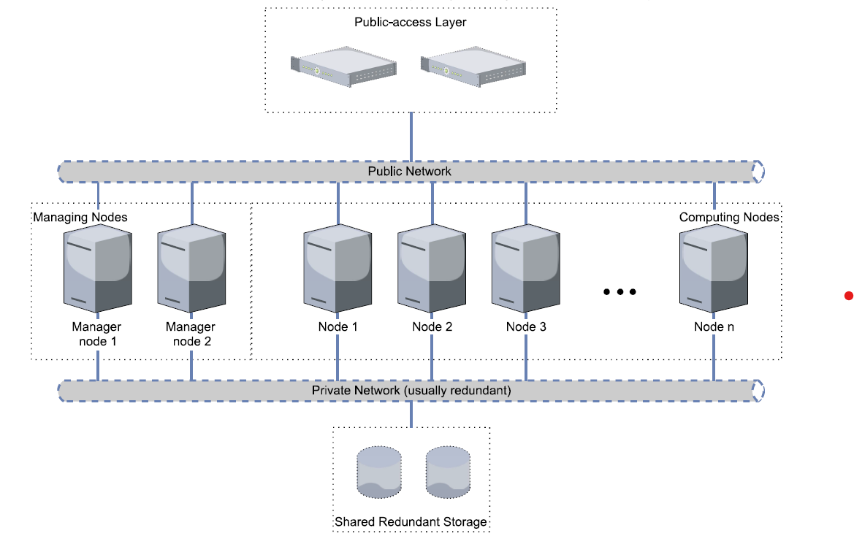
Clusters architecture

Slide 32
Examples of areas where clusters are used…
Big Data: The field of big data requires high amounts of computing power to handle, transform and process these large datasets.
Research: researchers often need more ressources to run cutting edges software and algorithms.
Weather forcasting: Requires heavy processing

Slide 33
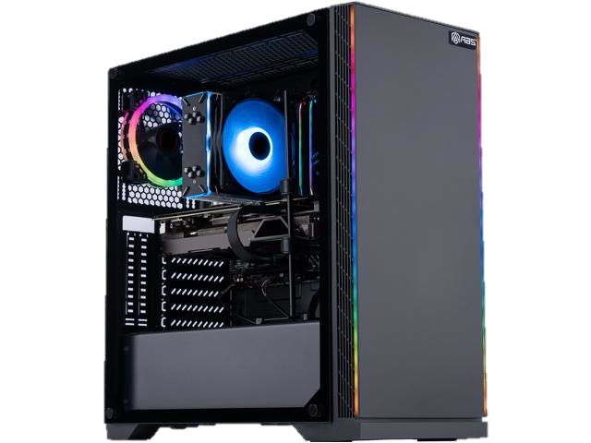
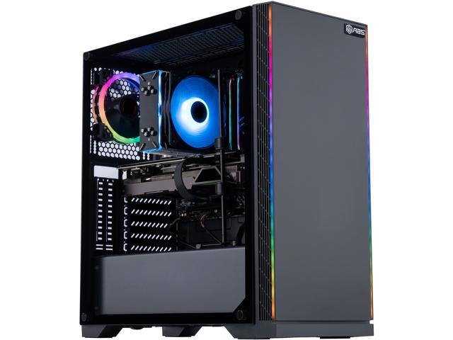
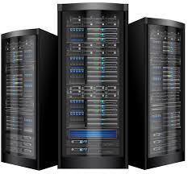
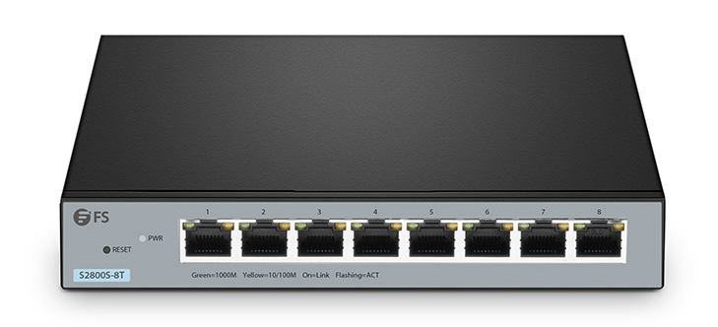
CentOs Server

Slide 34
Q & A
Notes:
In Slide Show mode, click the arrow to enter the PowerPoint Getting Started Center.

